Slide 1

AI-POWERED MOBILE ROBOT FOR GAS LEAK
DETECTION AND SAFETY CONTROL
BATCH MEMBERS:
727722EUEC078 - KAVIN INIYAVAN S
727722EUEC093 - LOGENDRA PRASANNA T
727722EUEC127 - PRAGNESH S
SUPERVISOR:
Dr. DINESH KUMAR J R
ASSISTANT PROFESSOR / ECE

Slide 2
CONTENTS:
INTRODUCTION
ABSTRACT
DOMAIN
OBJECTIVE
NOVELTY OF THE PROJECT
LITERATURE REVIEW
EXISTING METHODOLOGY
BLOCK DIAGRAM
FLOW CHART
HARDWARE REQUIRED
SOFTWARE REQUIRED
SCHEMATIC DIAGRAM
SUMMARY
REFERENCES

Slide 3
INTRODUCTION:
In industrial environments where LPG (liquefied petroleum gas) is stored and used, safety is a critical concern due to the high risk of gas leakage and potential explosions. To address this challenge, this project proposes the development of an autonomous gas-sensing rover designed to patrol along a fixed path within an industrial storage area. The rover continuously moves back and forth, scanning the environment for any signs of gas leakage near gas cylinders. Upon detecting a leak, it triggers multiple safety mechanisms simultaneously.
It sends a wireless signal to immediately shut off the power supply to the storage room.
Activates an alarm system to alert nearby personnel,
Sends a notification to the maintainer’s smartphone to ensure remote awareness.
By integrating gas detection with real-time alert systems and automation, this project aims to enhance safety measures in hazardous industrial zones.

Slide 4
ABSTRACT:
In industrial environments where liquefied petroleum gas (LPG) cylinders are stored, even minor leakages can lead to catastrophic explosions, especially when exposed to electrical sparks. To address this safety concern, we propose an autonomous gas-sensing rover system powered by the ESP8266 microcontroller.
The rover patrols a predefined linear path back and forth, continuously monitoring for LPG gas leakage near storage cylinders. It is equipped with gas sensors, an obstacle avoidance module with line following, and wireless communication capabilities.
Upon detection of a gas leak, the system performs critical safety actions in real-time. It triggers an alarm in the storage room, cuts off the power supply to eliminate any ignition sources, and sends an immediate notification to the user’s smartphone via Wi-Fi or Bluetooth. This smart gas-sensing rover enhances industrial safety by automating real-time leak detection and mitigation, minimizing human risk, and ensuring rapid emergency response.

Slide 5
DOMAIN:
Embedded with IOT
OBJECTIVE:
To design and develop an autonomous gas (LPG) sensing rover capable of patrolling a fixed linear path in an industrial environment to monitor for gas leaks.
To detect a leakage, the rover should immediately trigger safety protocols including shutting off the power supply to a miniature gas cylinder storage room, activating an alarm system to alert nearby personnel, and sending a real-time notification to the responsible user or maintainer to enable prompt action and prevent potential hazards such as fire or explosions.
To enhance industrial safety through continuous, automated surveillance of LPG storage areas. It minimizes human risk by enabling early detection and rapid response to gas leaks using integrated sensors and communication systems.

Slide 6
NOVELTY OF THE PROJECT:
The integration of a mobile gas sensing system with real-time automated safety responses, unlike conventional fixed gas detectors. The rover’s ability to patrol along a defined path allows dynamic area coverage, enabling early detection in multiple zones, and its automatic triggering of power shutdown, alarms, and user notifications enhances safety without requiring manual intervention.
Unlike traditional static monitoring systems, this rover adds mobility to improve gas leak detection coverage in industrial setups. The combination of autonomous movement, immediate safety actions, and user alerts makes it a cost-effective and scalable solution for hazardous environments.
This project uniquely combines mobility, sensing, and automation in a compact patrol robot for hazardous industrial zones. Unlike static detectors, it can cover more area and revisit locations, ensuring consistent safety checks. The immediate multi-response system—power cutoff, alarm, and mobile alert—minimizes reaction time. Its design is scalable for various industrial applications, making it a versatile safety solution.

Slide 7
LITERATURE REVIEW:
S.NO | AUTHOR AND YEAR | TITLE OF THE PAPER | OBSERVATION
1 | Bala Brahmeswara kadaru (2024) | IOT Based Gas Leakage Detection [IEEE 2024] | The system integrates gas leakage detection, container weight monitoring, and an automated booking system to comprehensively address gas safety and management. Leveraging real-time data analysis via the Thing Speak cloud platform, the system ensures swift responses to gas leaks by triggering alarms and automates the refill process.
2 | Pragatheeswari E, Vishnu Priya V (2024) | IoT Integrated Smart Rover System for Disaster Relief Management [IEEE 2024] | The primary objective is to develop a rover capable of remote operation via live video transmission, regardless of location. The proposed approach implemented with a plethora of sensors, the rover will provide continuous monitoring of crucial environmental factors such as temperature, humidity, among other variables.
3 | Shibani Bhattacharjee, (2024) | Real time gas leak detection with IOT: Agate way to safer and smarter homes [IEEE 2024] | This IoT-based automatic gas leakage sensor is designed to enhance safety in buildings and apartments. The system detects the presence of flammable gases such as methane, butane, and LPG. Upon detection, the sensor immediately activates a loud beep sound to alert occupants of the danger.

Slide 8
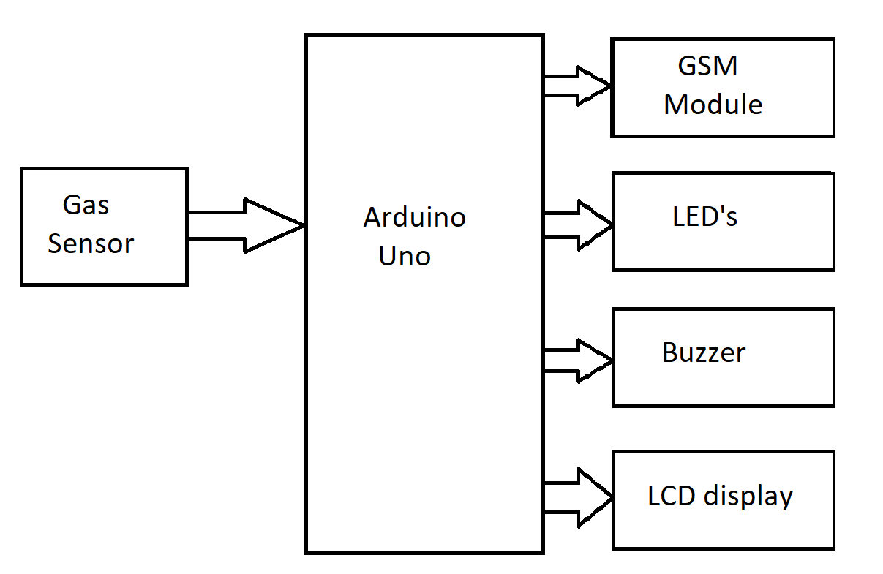
EXISTING METHODOLOGY:

Slide 9
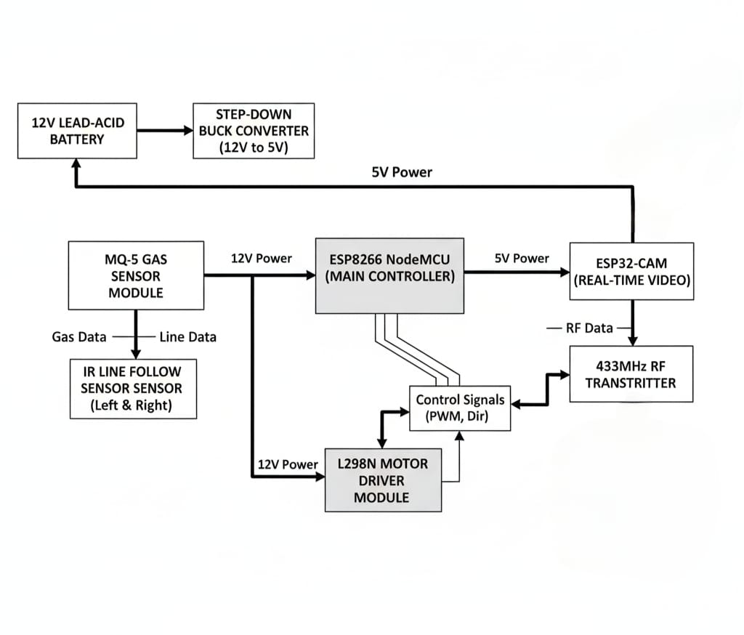
BLOCK DIAGRAM:
DC MOTOR
DC MOTOR

Slide 10
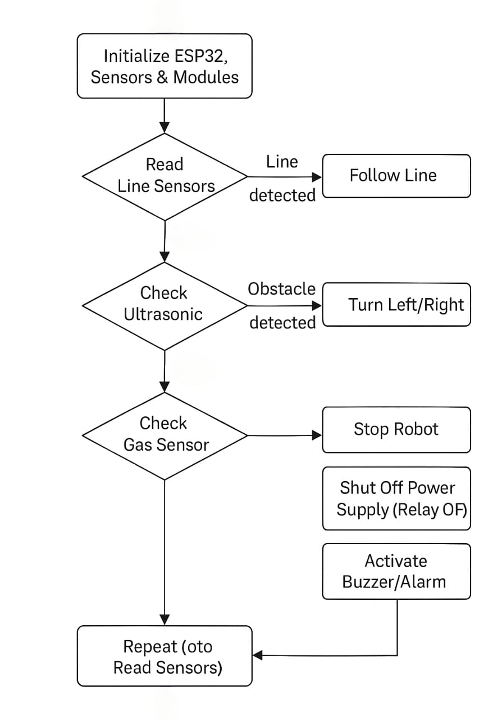
FLOW CHART :
ESP 8266
yes
yes
Human
no
yes
no

Slide 11
HARDWARE AND SOFTWARE REQUIRED:
Hardware Components
ESP8266 NODE MCU
MQ-5 or MQ-2 Gas Sensor
L298N Motor Driver Module
DC Geared Motors 2
4-Wheel Rover Chassis
IR Sensors
Relay Module
LCD Display
12v Lead acid Battery
Jumper Wires and Connectors
Breadboard or PCB
LEDs
Rf Transceiver
Software Tools
Arduino IDE
ESP8266 Board Package for Arduino
USB-to-Serial Driver (CP210x or CH340)
Blynk App / Telegram Bot / IFTTT (for notifications)
Serial Monitor (for debugging)

Slide 12
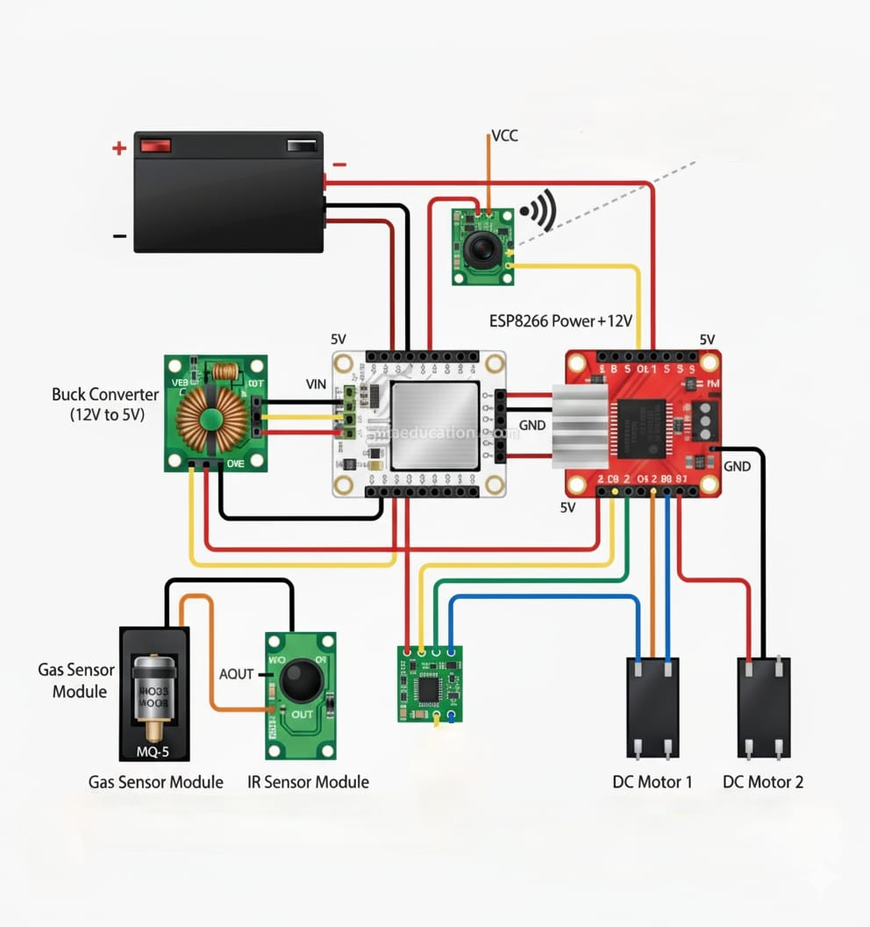
CIRCUIT DIAGRAM:
ESP
8266

Slide 13
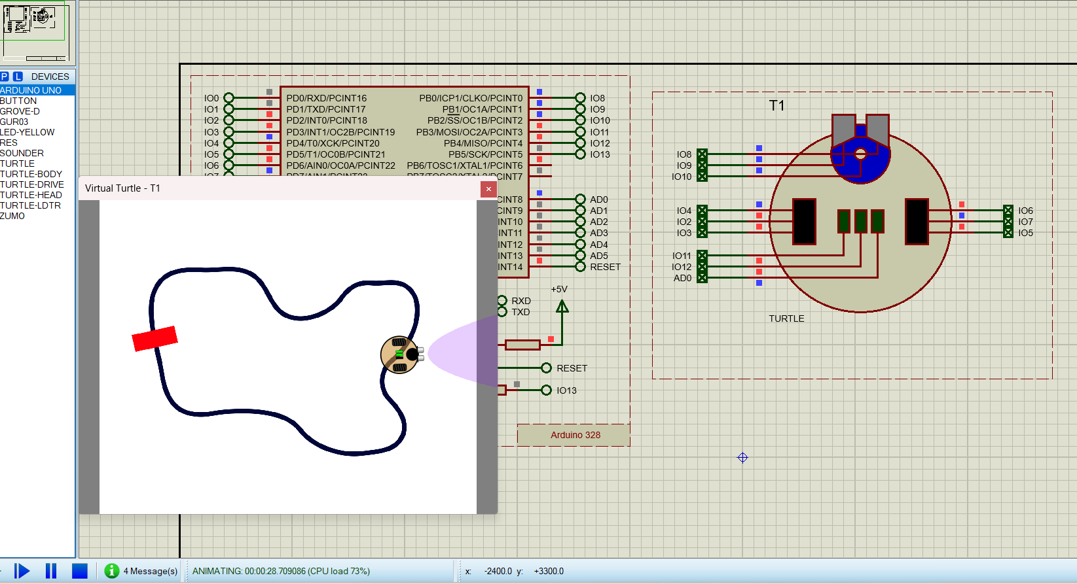
PROTEUS SIMULATION OUTPUT
LINE FOLLOWER & AVOID OBSTACLE

Slide 14
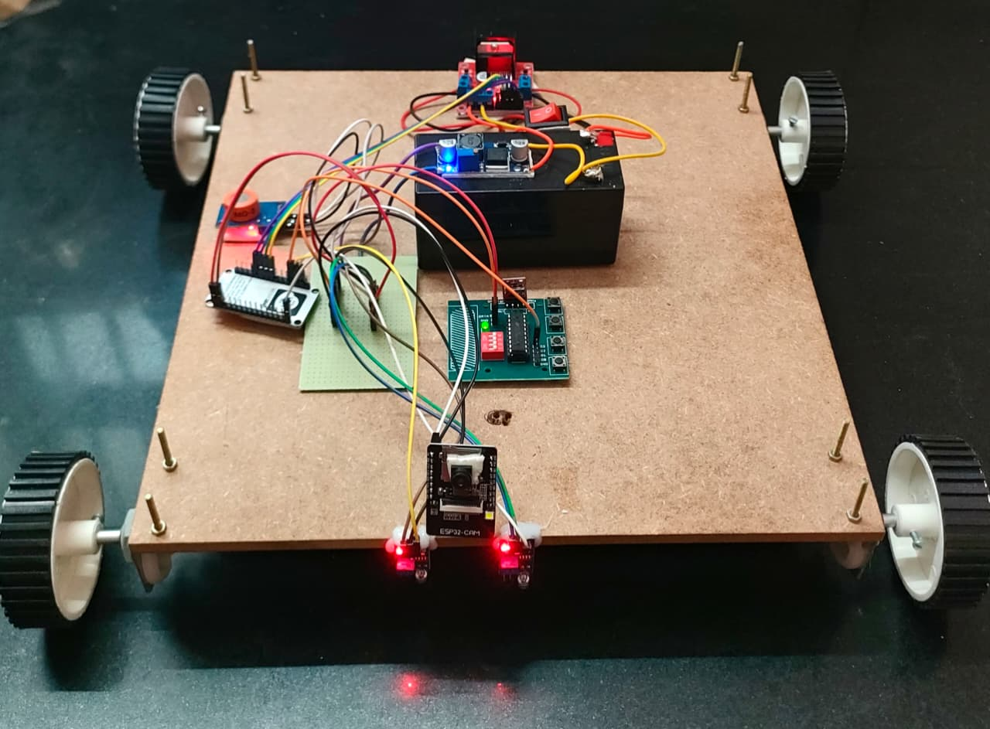
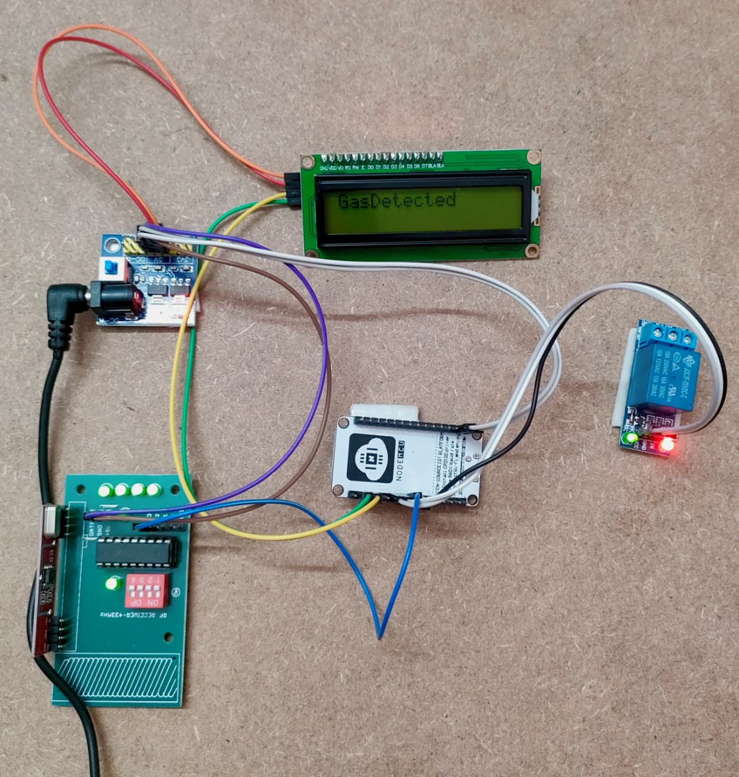
PROTOTYPE

Slide 15
SUMMARY:
The proposed gas-sensing rover system effectively enhances safety measures in industrial environments where LPG cylinders are stored. By integrating the ESP8266 microcontroller, gas sensors, obstacle avoidance modules, and wireless communication capabilities, the rover can autonomously patrol a designated area in a linear path.
Upon detecting an LPG leak, the system promptly triggers a series of safety protocols: it sends an immediate signal to cut off the power supply to the miniature storage room, activates a local alarm system to alert nearby personnel, and sends a real-time notification to the user's mobile device. This layered response ensures rapid detection and mitigation of potential hazards, thereby significantly reducing the risk of fire or explosion.
The project demonstrates a cost-effective, efficient, and scalable solution for gas leak detection and response in industrial settings, with the potential for future enhancements such as real-time video monitoring, path optimization, and cloud-based analytics for predictive maintenance.

Slide 16
REFERENCES:
D. S. Simbeye, “Gas Leakage Detection System (GLDS),” Tanzania Journal of Engineering and Technology, vol. 34, no. 1, 2017.
Z. H. Soh, S. A. Abdullah, M. A. Shafie, and M. N. Ibrahim, “Home and industrial safety IoT on LPG gas leakage detection and alert system,” Int. J. Advance Soft Compu. Appl, vol. 11, no. 1, 2019.
R.Macfos, Ed., “MQ Series Gas Sensor,” Robu.in | Indian Online Store | RC Hobby | Robotics, 16 - Aug - 2020. [Online]. Available: https://robu.in/mq-series-gas-sensor/.
T. with ESP32, “The internet of things with ESP32,” The Internet of Things with ESP32, 2020.http://esp32.net/.
T. Nguyen and A. V. Nguyen, “IoT Application for Gas Leakages Monitoring,” Engineering and Science, vol. 5, no. 4, pp. 51 - 53, 2020.
Y. Chen and Y. Zhang, “Development of an IoT-based gas detection system for smart homes,” Journal of Sensors and Actuators, vol. 43, no. 2, pp. 101 - 110, 2020. doi: 10.1016/jsenact.2020.03.015.

Slide 17
THANK YOU

